Slide 2
Cognitive
Affective
Behavioral

Slide 3
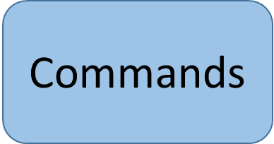
Gospel
Theology

Slide 4
Intellectual
MS Student
Seeker
Spiritual Leader

Slide 5
God is Triune?
image from cliparts.co

Slide 6
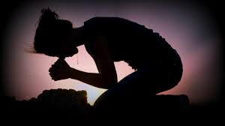
image from hqwallbase.com

Slide 7
Reflect:
If believers are
branches of the
vine that is Christ, what is the source of our life and vitality? Can we
have true life
apart from Christ? Can we be fruitful for God apart from Christ? What do you think about the relative importance of our own efforts to accomplish things compared to the importance of remaining closely connected with Christ? Should this change how you approach daily life? how you approach helping others or serving in church?

Slide 8
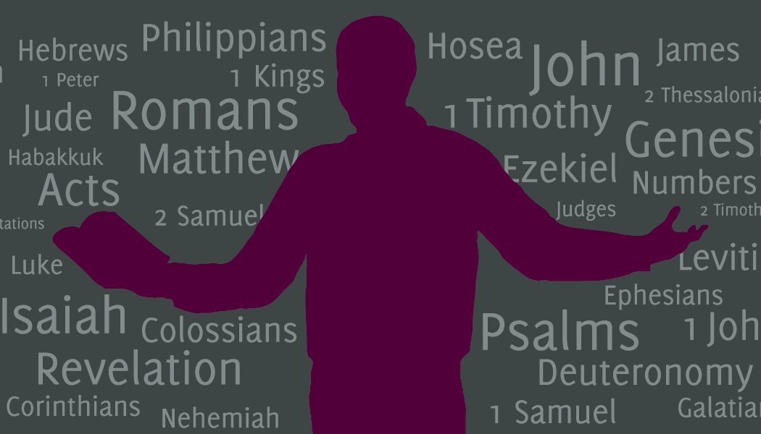
image by Jessica Willett

Slide 9
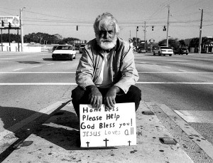
image from tillhecomes.org

